Slide 1

Regression _Project:
Title: Carbon Dioxide Emission from Agricultural Sector
Subtitle: Project by Akona Ciko

Slide 2

Agenda
Introduction
Dataset Summary
Methodology
Key Visuals and Insights
Conclusions
Future Directions
Contact & Questions

Slide 3


Introduction
Overview: This project analyzes CO₂ emissions within the agricultural sector to understand its environmental impact and potential areas for emission reduction.
Objective: The goal is to provide insights that help policymakers, environmental consultants, and agricultural businesses develop sustainable, low-emission strategies.
Significance: Highlights the importance of balancing food production demands with climate change mitigation.

Slide 4

Dataset Summary
Source: Data collected from an authorized source (“carbon dioxide_emissions_from_agric.csv”)
Key Features_
Area: Geographical regions analyzed
Year: Time period covered
Agricultural Activities: Emission sources such as Crop Residues, Rice Cultivation, Pesticides Manufacturing, Food Transport
Population Metrics: Rural and urban population figures, total emissions, average temperature, and emissions per capita (urban/rural).
Data Scope: Emissions tracked across different agricultural processes and population groups.

Slide 5
Methodology
Data Processing_
Initial cleaning of missing data and handling outliers
Feature engineering to create new metrics such as Emissions per Capita (Rural) and Emissions per Capita (Urban) for a more nuanced analysis.
Analysis Tools_
Data Analysis: Pandas, NumPy
Statistical Modeling: Scipy, Sta2tsmodels
Visualization: Matplotlib, Seaborn
Machine Learning: Scikit-Learn for regression modeling
Geospatial Analysis: GeoPandas and Shapely for mapping emissions geographically.

Slide 6

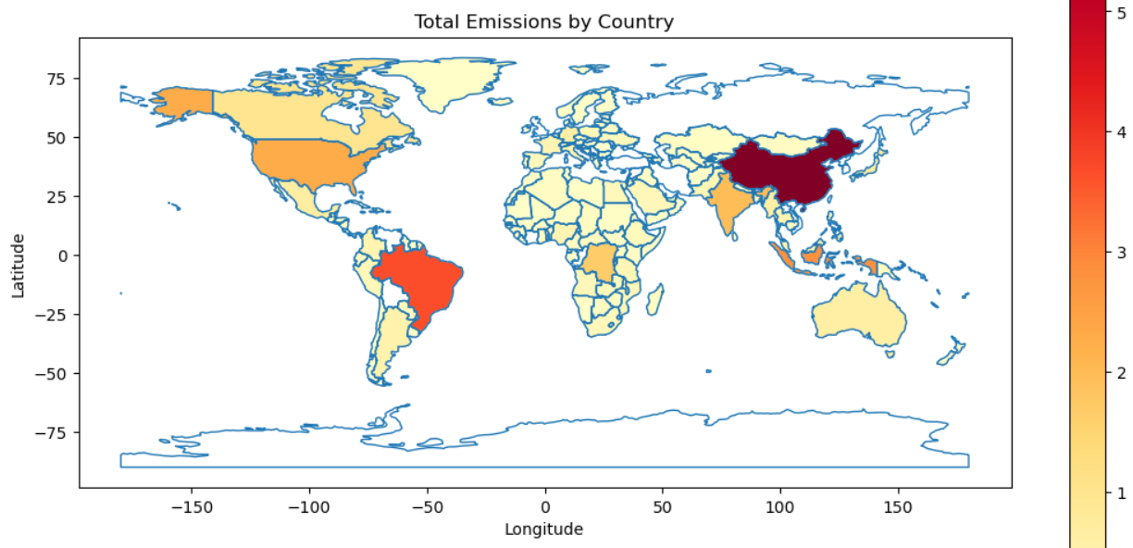
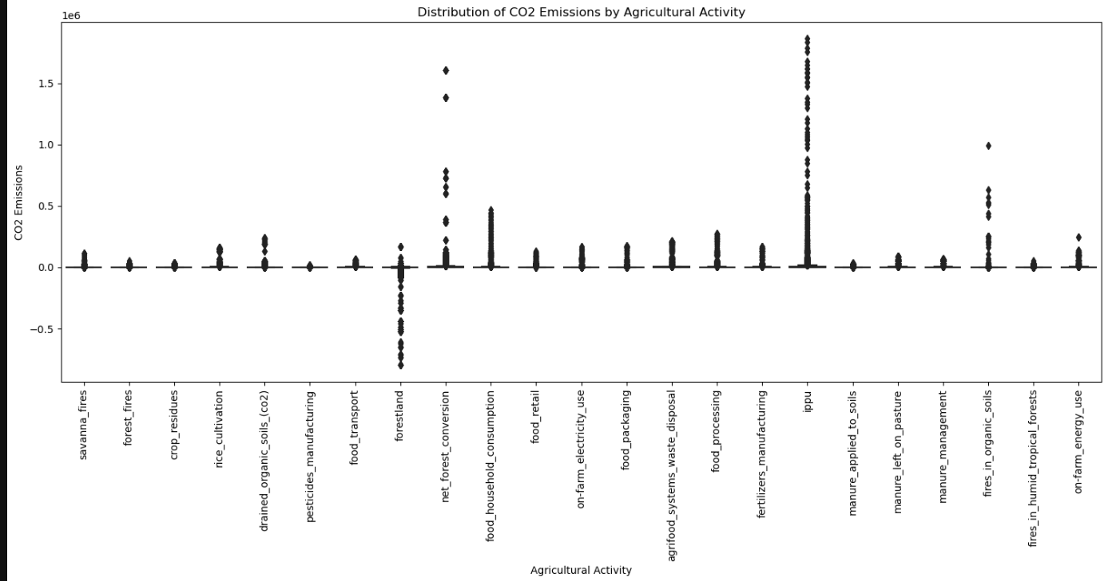
Key Visuals & Insights
Geographic Emissions Map_
Box Plot of Emissions by Activity_
Insights_ Geo Emission Map:
Certain countries or regions have significantly higher emissions, often influenced by extensive agricultural activities like deforestation or rice cultivation.
Insights_ Box plot
Activities like Forestland Conversion and IPPU (Industrial Processes and Product Use) show high variability, indicating areas with major emission impacts.
Outliers: Significant outliers suggest that some activities have disproportionately high emissions compared to others.

Slide 7

Conclusions
Key Findings_
Emission Hotspots: Specific activities such as Fertilizers Manufacturing, Manure Management, and Forestland Conversion contribute substantially to total emissions.
Geographical Variations: Regions with large agricultural sectors or extensive deforestation exhibit higher CO₂ emissions.
Actionable Insights_
These findings can guide targeted interventions in high-emission areas, like promoting sustainable farming practices or reducing deforestation for agricultural land.
Implications for Policy_
The insights support climate policies aimed at emission reduction and can help in setting sector-specific emission targets in agriculture.

Slide 8

Future Directions
Next Steps_
Enhanced Modeling: Apply advanced machine learning models to better predict emissions based on agricultural practices and geographical factors.
Incorporate Other Greenhouse Gases: Expand analysis to include methane (CH₄) and nitrous oxide (N₂O), which are also significant in agriculture.
Longitudinal Analysis: Examine trends over time to see how emissions have evolved and where interventions have been effective.
Potential Collaboration: Work with policymakers, environmental consultants, and agricultural experts to validate insights and develop practical strategies for reducing emissions.

Slide 9


Thank you
Akona Ciko
Email: Akona.Ciko@fnb.co.za / Akonaciko1@gmail.com
Username_ (GitHub): Gibit1
Q&A Prompt_
Happy to discuss any aspects of the project further!
Feel free to ask about my methodology, specific insights, or how these findings can influence sustainable practices in agriculture.
Further details are available upon request

